Slide 1
INTERNSHIP OPPORTUNITIES WORKSHOP

Slide 2
AGENDA
What is SIP?
How do I find opportunities?
How do I apply?

Slide 3
Sciences Internship Program
Promoting Student Success in STEM
SIP

Slide 4
Advertising Opportunities
Creating new internship positions
Recruiting for select community partners
Referral services
UROC, Career Services, Center for student success, ASAP
What we do

Slide 5
One-on-one Meetings with students
Advising, connect to resources
Tips for job searches
Coordination of Science Internship Classes
Helping you get credit for your internship
What we do

Slide 6
Visit us at
csumb.edu/sip

Slide 7


SIP
Internships augment your academic preparation:
Real-world experience and training
Development of disciplinary skills and knowledge
Familiarity with professional environment and workplace expectations
Professional networking
Portfolio and resume building

Slide 8
How do I find Internship opportunities?

Slide 9
Activity
Develop a search strategy
Define what you want to get out of an internship experience
Create a list of keywords that describe your discipline and research interests
Consider your ultimate career goals, and list any organizations that you would consider for future employment

Slide 10
Considerations
Disciplinary focus and training opportunities
Eligibility and requirements
Time commitment
Location
Pay or stipends
Travel, housing, and living costs
Networking and professional development opportunities

Slide 11
Places to Look
General Job Sites: Monster.com; Simplyhired.com; Indeed.com; Craigslist.com
Internship Aggregators: Internships.com; Experience.com; Internmatch.com
Idealist.org
Student Conservation Association: thesca.org
USA Jobs Portal: usajobs.gov

Slide 12
Places to Look
Pathways to Science: http://www.pathwaystoscience.org
NSF REU List: http://www.nsf.gov/crssprgm/reu
CIC SROP List: http://www.cic.net/students/srop
Leadership Alliance SR-EIP: http://www.theleadershipalliance.org
Federal Agency Internship Programs: http://www.science.gov/internships
NASA OSSI: https://intern.nasa.gov
USDA ARS: ars.usda.gov/careers/docs.htm?docid=1345

Slide 13
Places to Look
Search Professional Societies in your discipline:
Into medicine? Check out the AAMC: https://www.aamc.org/members/great/61052/great_summerlinks.html
Into oceanography? Check out ASLO: http://www.aslo.org/employment/studentops.html
Into ornithology? Check out OSNA: http://www.osnabirds.org/Jobs.aspx
Into husbandry? Check out the AZA: https://www.aza.org/joblistings/

Slide 14
Places to Look
Monterey County: co.monterey.ca.us/intern/
Monterey Bay Aquarium: montereybayaquarium.org/about/internships
MBARI: mbari.org/education/internship/
Naval Postgraduate School: nps.edu/About/STEM/LocalCommunity/local.html
Hopkins Marine Station: hopkins.stanford.edu/internships.html
Elkhorn Slough: elkhornslough.org/research/forresearchers.htm
National Marine Sanctuary: montereybay.noaa.gov/getinvolved/volunteer/internship.html

Slide 15
Places to Look
csumb.edu/sip
csumb.edu/career/otter-jobs
csumb.edu/uroc

Slide 16
Find Your Own
Many organizations would consider an intern if approached properly:
Identify organizations that you would be interested in interning with, and think about possible projects you could propose.
Do your homework – find out what the organization does and how it is structured. Identify key individuals to contact.
Write a short email to introduce yourself and to state your objectives and qualifications. Attach a cover letter and resume.
Follow-up with telephone calls and emails as appropriate. Always be courteous and professional.

Slide 17
How do I apply?

Slide 18
Parts of an Application
Application Form
Academic Resume or Curriculum Vitae (CV)
Cover Letter or Personal Statement
References or Letters of Recommendation
Additional Documents (Portfolios, Transcripts, etc.)

Slide 19
Steps for Applying
Get organized:
Review job posting or program descriptions, highlight keywords, and note eligibility requirements, application deadlines, and submission instructions.
Begin drafting letters, statements, and resumes.
Seek input and feedback from faculty, peers, and family.
Request recommendation letters as early as possible.
Submit application materials as prescribed.

Slide 20
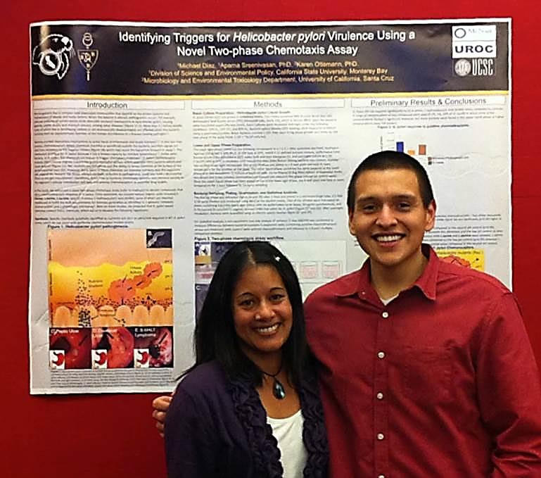
Discussion
What are reviewers looking for?

Slide 21
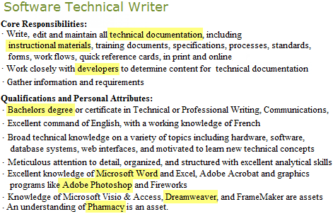
Activity
Identify Keywords

Slide 22
Invasive Plant Mapping Technician
Employer: Albany Pine Bush Preserve Commission Location: Albany, New York
Job Description: The technician will undertake invasive plant species mapping throughout the preserve.
Job Duties: Duties will include orienteering to various preserve locations and completing exhaustive vegetation surveys for invasive plant species. When invasive species are located, information including species name, GPS location, population size, etc. will be collected on a Trimble handheld computer/GPS unit. All data will be downloaded daily to office PCs and GPS data will be post-processed. Additionally, while in the field any rare or interesting flora will be noted as well.
Requirements:
Bachelor's degree in natural resource management or equivalent experience
Interest in land management, invasive species, conservation, and GIS/GPS mapping
Ability to use maps, compass, GPS, GIS, and aerial photos; ability to orient oneself in the field
Proficiency with ArcMap GIS mapping software
Proficiency with GPS, experience using Trimble GPS units with ArcPad a plus
Excellent plant identification skills, familiarity with common Northeastern US invasive plant species
Ability and willingness to perform difficult physical work for extended periods, in variable weather
Innovative critical thinking skills, ability to problem solve as well as propose ideas to streamline and improve performance in the field
Ability to remain productive and perform well under minimal and at times distant supervision
Valid driver’s license; ability to drive four-wheel drive and manual shift vehicles
First aid/CPR training and certification is desirable
APPLICATION DEADLINE: April 15, 2011
Please e-mail cover letter, résumé, and 3 references to: jhoffman@albanypinebush.org.
Please put: INVMAPTECH in subject line

Slide 23
Invasive Plant Mapping Technician
Employer: Albany Pine Bush Preserve Commission Location: Albany, New York
Job Description: The technician will undertake invasive plant species mapping throughout the preserve.
Job Duties: Duties will include orienteering to various preserve locations and completing exhaustive vegetation surveys for invasive plant species. When invasive species are located, information including species name, GPS location, population size, etc. will be collected on a Trimble handheld computer/GPS unit. All data will be downloaded daily to office PCs and GPS data will be post-processed. Additionally, while in the field any rare or interesting flora will be noted as well.
Requirements:
Bachelor's degree in natural resource management or equivalent experience
Interest in land management, invasive species, conservation, and GIS/GPS mapping
Ability to use maps, compass, GPS, GIS, and aerial photos; ability to orient oneself in the field
Proficiency with ArcMap GIS mapping software
Proficiency with GPS, experience using Trimble GPS units with ArcPad a plus
Excellent plant identification skills, familiarity with common Northeastern US invasive plant species
Ability and willingness to perform difficult physical work for extended periods, in variable weather
Innovative critical thinking skills, ability to problem solve as well as propose ideas to streamline and improve performance in the field
Ability to remain productive and perform well under minimal and at times distant supervision
Valid driver’s license; ability to drive four-wheel drive and manual shift vehicles
First aid/CPR training and certification is desirable
APPLICATION DEADLINE: April 15, 2011
Please e-mail cover letter, résumé, and 3 references to: jhoffman@albanypinebush.org.
Please put: INVMAPTECH in subject line

Slide 24
Keywords
Use the language that the posting uses:
Degrees or Certifications
Job Titles
Job duties, skills, or abilities
Product Names
Technical Terms
Industry Jargon
Job-specific Buzzwords
University or Company Names
Service Types
Professional Organizations
Software or Hardware Packages

Slide 25
Develop your résumé
Analyze: Highlight required/preferred skills & qualifications in job description
Evaluate experiences and skills: Which of your skills and experiences are relevant to the position?
Write descriptive phrases: A short phrase for each of your skills or experiences; arrange in order of relevance
List accomplishments: Provide evidence of what you can do, using examples from your education, training, and experience; describe what you did & quantify your results

Slide 26
Academic Resume or CV
Customize your resume or CV for your audience
Use consistent formatting so that your resume or CV look professional and information is easy to find
Include relevant academic and work experiences, honors, leadership activities, and skills and training
Write active descriptions of experiences focusing on accomplishments and ‘end products,’ not lists of duties
Sell yourself – highlight content that will impress your audience
Take ownership of your experiences – convey what you can do

Slide 27
Academic Resume or CV
Strive for
Avoid
What did you do, accomplish, or contribute?
Conducted
Investigated
Designed
Developed
Determined
Passive phrasing with no ownership
Worked with…
Gained understanding…
Assisted with…
Enabled me to…
Laundry lists of duties

Slide 28
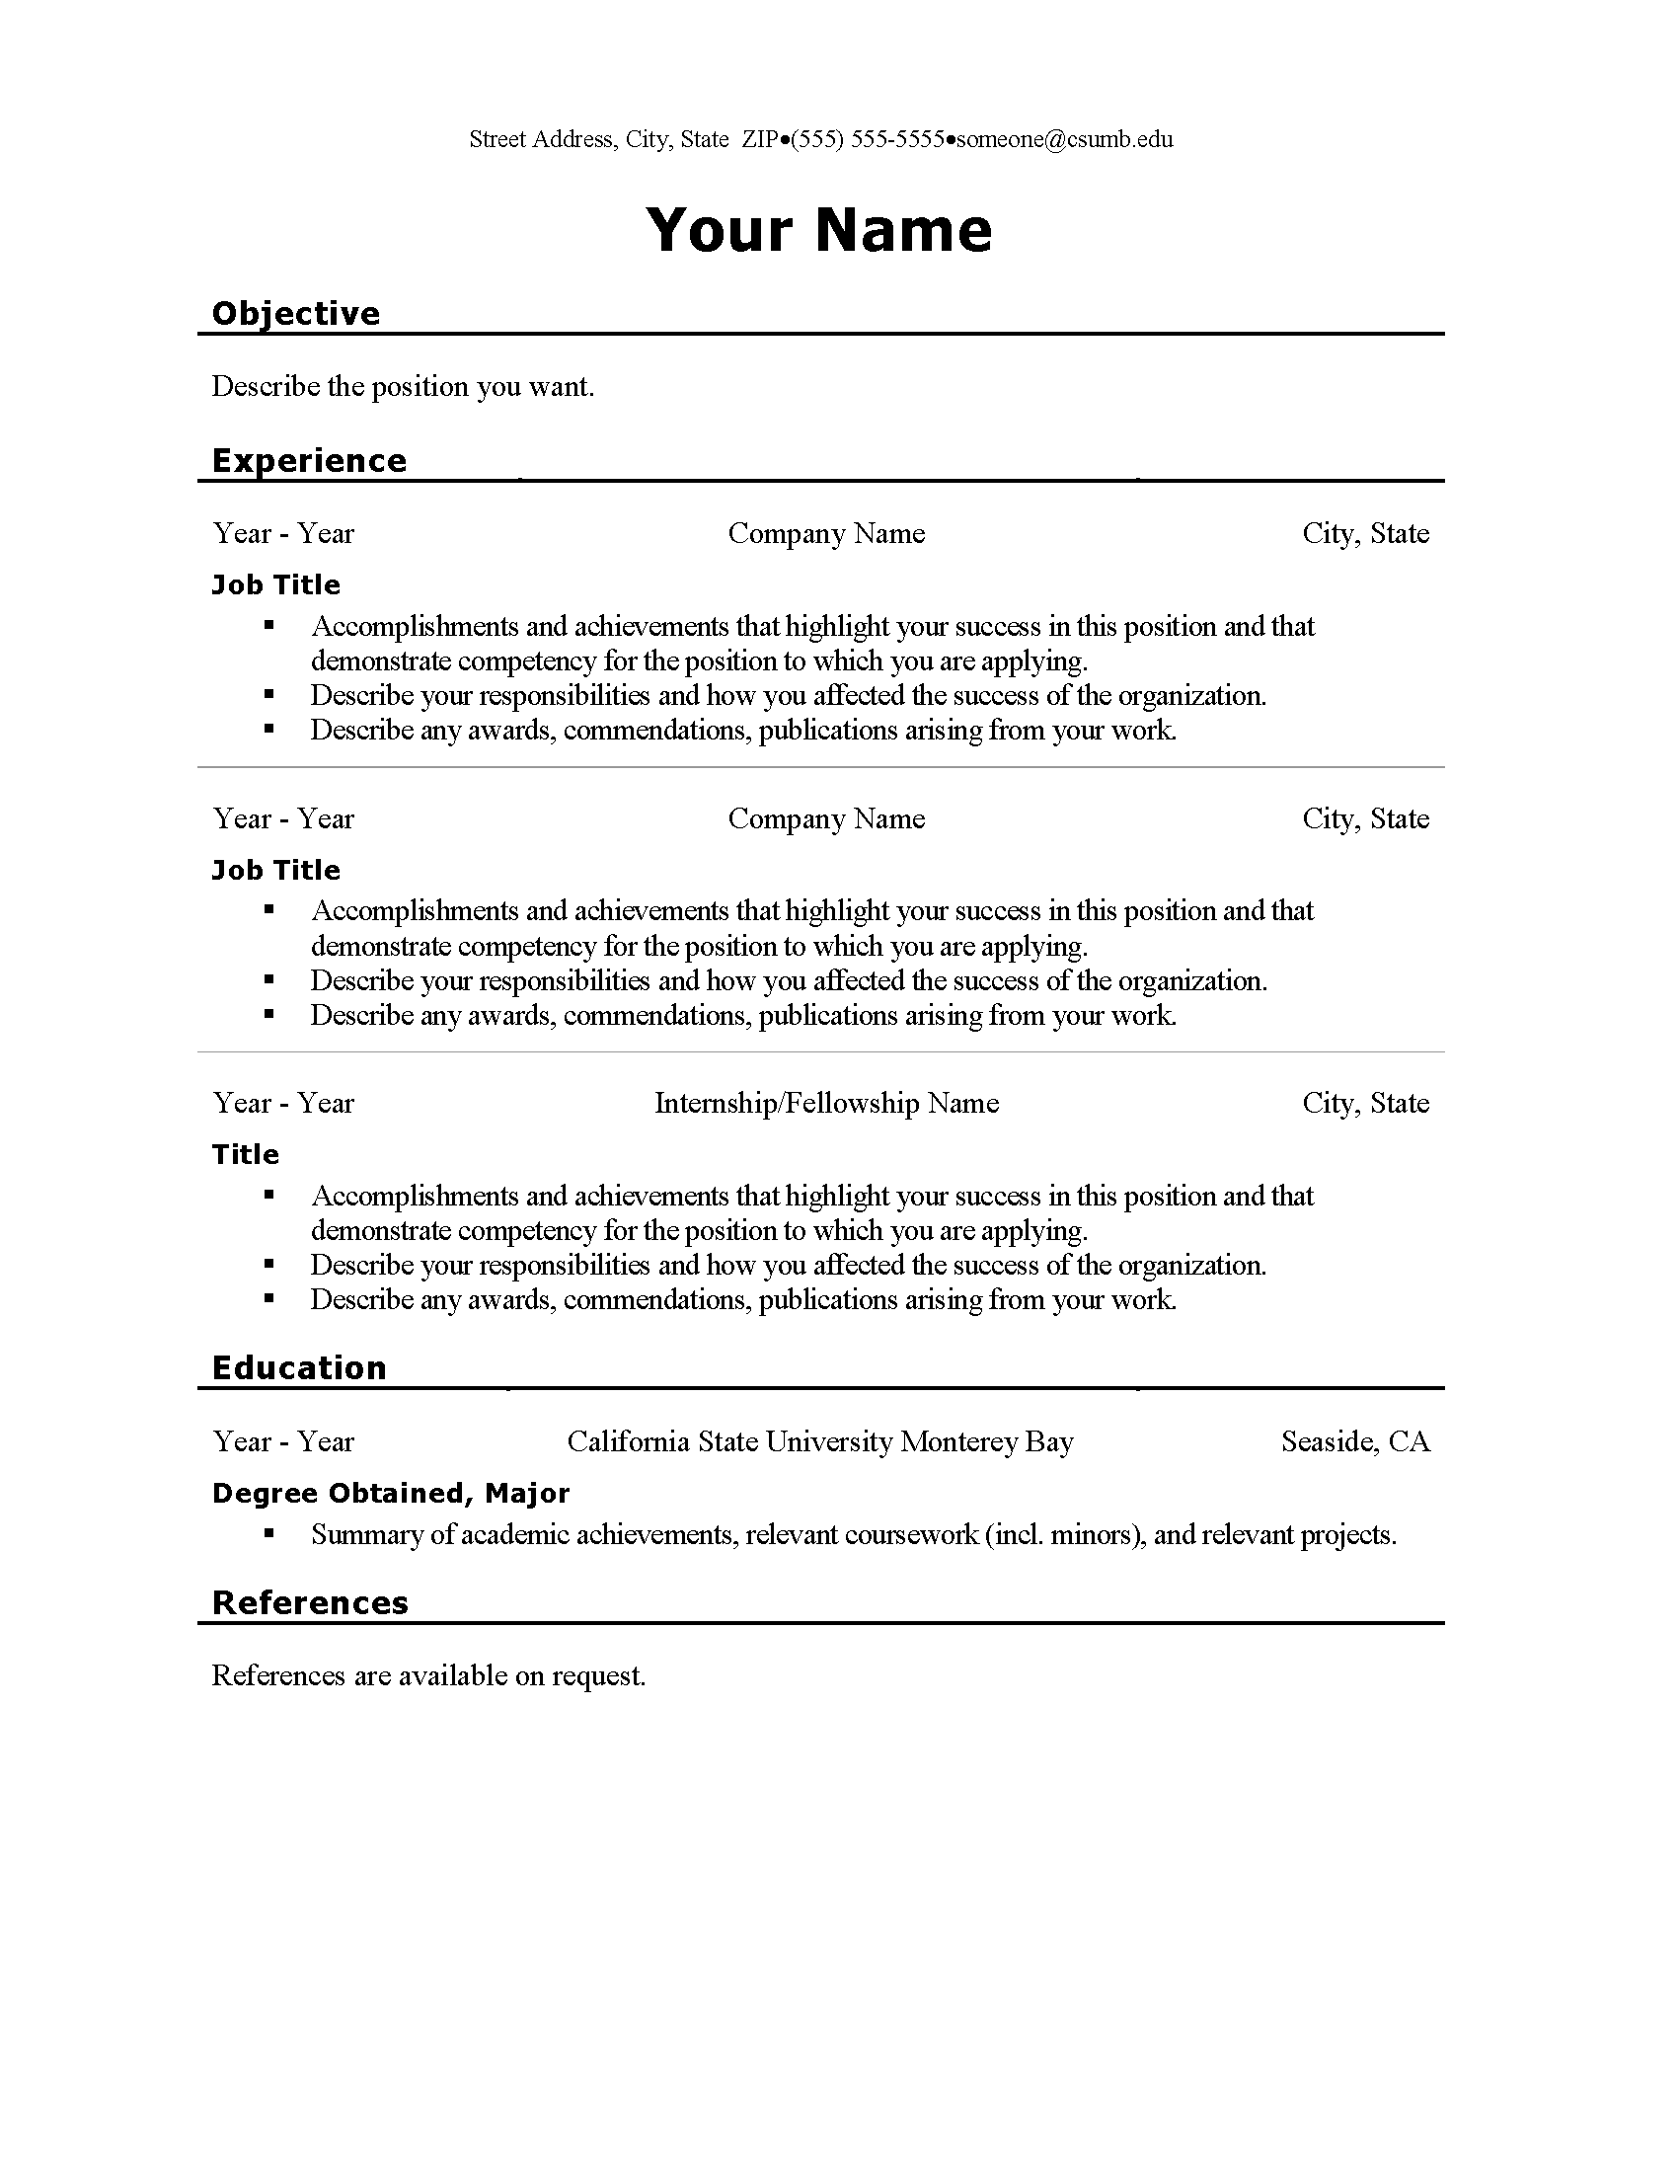

Slide 29
Cover Letters
AKA “statement of purpose,” “letter of intent,” “personal narrative,” etc., or may be in the form of an essay or series of questions
Carefully address specific details from advertisement or posting; answer specific prompts if provided
Tailor letters to individual positions or programs
Avoid cliché and simple biographies
Talk about your specific skills and experiences and how they lead to your goals.

Slide 30
Cover Letters
General Prompts:
What are my academic and career goals? What is my purpose and motivation to achieve these goals?
Why am I interested in this position or institution?
Why am I an excellent fit for this position?
What preparation and personal attributes do I have that demonstrates I will succeed? What can I contribute to the position and institution?
How will my participation help me achieve my academic and career goals?

Slide 31
Jonathan Lopez
November 20, 2013
Sandy Smith
Student Employment Programs Manager
U.S. Department of Agriculture
1400 Independence Ave., SW
Washington, DC 20250
Dear Ms. Smith,
As a third year student in Environmental Science Technology and Policy with a minor
in Marine Biology, I am interested in expanding my skills in research through an
internship with the USDA. The scientific research summer internship position listed
through CSU Monterey Bay’s Career Services website is the type of position that not
only can build my skills, but will contribute to improve chemicals used to grow in
vegetables.
I have laboratory and field experience in chemistry, biology, and ecology. I have
performed tests on water samples, examined specimens for reactions to toxins
at the Salinas River, and entered findings into databases for analysis. I have
conducted outdoor labs to assess water chemistry. Last summer, I worked
as conservation assistant at Yosemite National Park.
I believe that I would be an asset to your program. Thank you and I look forward
to hearing from you. Attached is my résumé.
Sincerely,
Jonathan Lopez
Jonathan Lopez
Current Address:
206 Willet Hall
Seaside, CA 93955
jlopez@csumb.edu
(234) 567-8012
Permanent Address:
209 Sepulvelda Blvd.
Los Angeles, CA 90003

Slide 32
Emailing Cover Letters
Write an email whose content is an “abstract” of your cover letter.
Introduce yourself concisely, in 1-2 sentences
Summarize your qualifications and interest
Consider ending with straight forward question or request (e.g. asking for information or interview) to encourage correspondence.
Attach full cover letter and resume. Be sure to refer to them in the text of your email.

Slide 33
Activity
Brainstorm your cover letter
What do you want to do or gain by participating in an internship?
What motivates you to pursue an internship, and how does this position relate to your goals?
What training and experiences have prepared you for an internship?
What attributes do you have that will allow you to succeed?

Slide 34
Recommendation Letters
Build relationships with potential references and letter writers
Choose references and letter writers carefully
Provide letter writers ample time
Provide letter writers with necessary information:
Program description and instructions for submitting letter
Your application materials
Information you wish for them to include in their letter
Send reminders and thanks

Slide 35
Activity
Plan your letter requests
Attribute | Letter 1 | Letter 2 | Letter 3

Slide 36
Learn More
csumb.edu/sip
csumb.edu/uroc
csumb.edu/career

