Slide 1
CSUBUY: Procure-to-Pay (P2P)
Demo Series: Town Hall
Notes:
Speaker: Sara
Hello and welcome to the final session of the CSU Systemwide CSUBUY Procure-to-Pay — or P2P — Demo Series. P2P is a powerful tool that brings together multiple functions under one platform, including:
Supplier self-registration and access to a systemwide shared supplier database
Requisition entry and purchase order issuance
Receipt tracking and payment processing
And a centralized location for routing and collecting all necessary financial and compliance approvals
By integrating these capabilities, P2P supports greater efficiency, transparency, and consistency in our procurement and payment activities across the CSU system. The demos in this series covered: Supplier, Shopper/Requester, Workflow and Approver, Change Order, Carts and Searches, and Vouchers and Receiving. We also covered targeted compliance demos including: Independent Contractor, Facilities, IT, and Branding and Logo. If you happened to have missed any of the previously conducted demos, they should be listed on your campus CSUBUY P2P website. The Q&A feature will remain open throughout today’s session, and we’ll do our best to answer as many questions live as possible. We’ll also share the name and contact information for your campus lead, so you know who to reach out to with campus-specific questions or follow-up needs. Once again, thank you for being here — let’s get started.

Slide 2
Agenda
Introduction into CSUBUY
Timeline
General Project Update
Q & A
Notes:
Speaker: Sara
Here’s what we’ll cover in today’s session. We’ll start with a brief introduction to CSUBUY, then review the overall project timeline and current status and then we'll jump into the Q&A.

Slide 3
CSUBUY P2P:
Project Vision & Goals Review
Notes:
Speaker: Tawny
Let’s take a moment to review the vision and goals of CSUBUY P2P. Understanding the ‘why’ helps us better understand the design and decisions that have shaped this project.

Slide 4

CSUBUY P2P: Vision
It is the implementation of strategic, standardized procurement processes that allows for the elimination of manual touchpoints and steps resulting in efficiencies through automation, risk mitigation and cost savings for the California State University
Notes:
Speaker: Tawny
Our vision for CSUBUY P2P is to standardize procurement processes across the CSU, reduce manual steps, and drive efficiencies through automation. Ultimately, this means saving time, reducing risk, and lowering costs.

Slide 5
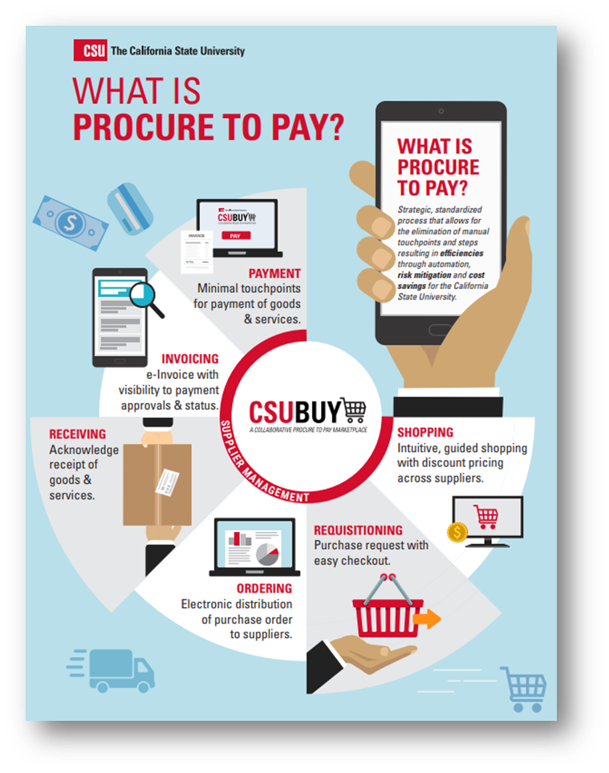
CSUBUY P2P: Objectives
Develop a systemwide platform that integrates disparate data and processes into one streamlined solution
Implement an intuitive and easy to use solution
Create visibility to preferred and sustainable suppliers and guide end users to contracted suppliers.
Drive process efficiency through integration and automation to reduce manual work
Improve compliance and reduce costs
Notes:
Speaker: Tawny
The objectives of P2P are centered around creating a streamlined, integrated platform that simplifies and enhances how we manage procurement and payments across the CSU system.
The graphic on this slide visually represents the entire procure-to-pay lifecycle and the key functions that P2P supports. Starting with shopping for goods and services — users can engage in purchasing with access to preferred, contracted, and sustainable suppliers. This flows into requisitioning, ordering, and receiving, all of which are handled in a centralized environment with fewer manual steps. The process concludes with invoicing and payment, emphasizing automation, minimal touchpoints, and visibility throughout.
What’s important to understand is that P2P will replace many of the fragmented, campus-specific tools and manual workflows currently in use. It consolidates supplier management (including supplier self-registration and a shared systemwide supplier database), requisition creation, purchase order (PO) issuance, receipts, and invoice processing — all into one cohesive system. While P2P will integrate with PeopleSoft CFS, allowing for necessary financial synchronization, the day-to-day work will take place within the P2P platform. For example, users will initiate and approve requisitions, manage POs, and review receipts and invoices all within P2P.

Slide 6





CSUBUY P2P: Benefits
Streamline Procurement and Payment Processes: Consolidate disparate data and processes into a single stream​​lined electronic solution, increasing automation to reduce manual inefficiencies
Improve User Experience: For both suppliers and internal customers, CSUBUY P2P will offer an intuitive and simplified experience.
  Suppliers will benefit from electronic receipt of PO’s and submission of invoices, timely payment and self-service access to check invoice approval and payment status.
  Internal Customers will have easy shopping and check out, access to order and payment status, and a single tool for reconciliation of purchases and payments
Better Data Quality for Decision Making: Improve reporting capabilities, enabling CSU to better identify shared suppliers and leverage negotiating power to drive cost savings.
Increased Visibility: One consolidated P2P system will increase access to data and information for both CSU employees and our suppliers, enabling cross campus visibility in key areas.
Continuous Improvement: CSUBUY P2P drives forward the strategic, systemwide focus on continuous improvement to increase efficiency and effectiveness throughout the organization.​
Notes:
Speaker: Carrie
The P2P platform offers a range of valuable benefits. For suppliers, it ensures timely payments and provides convenient self-service tools to track invoice and payment status. For internal users, it streamlines the purchasing experience and automatically routes requisitions and purchase orders to include all necessary financial and compliance approvals. The new P2P platform will replace the current CSUBUY Marketplace that requires a PCard to complete transactions, so it will also reduce the amount of monthly transactions that will need to be reconciled. At a systemwide level, the platform enhances data quality, increases visibility across campuses, and supports our ongoing commitment to operational efficiency, accountability, and strategic improvement.

Slide 7

CSUBUY: Acceleration Timeline
Resource Planning & Campus Assessments
Acceleration Implementation
Deployment &
Hypercare
DOA Enhancements & Integration Build
DOA Production Readiness & Promotion
Production Readiness Activities
Notes:
Speaker: Carrie
This slide shows our high-level timeline. The 14 campuses that are part of this acceleration project are currently in the implementation phase, with readiness and deployment activities scheduled through early 2026.

Slide 8
CSUBUY P2P: Campus Contacts
Campus | Contact | Email
Cal Poly Pomona | Sergio Rodriguez | sergior1@cpp.edu
Channel Islands | Greg Stoup | Gregory.Stoup@csuci.edu
Dominguez Hills | Maria Hernandez | Mehernandez@csudh.edu
East Bay | Chris Lam Vazquez | Chris.Lam-vazquez@csueastbay.edu
Fullerton | Caroline Lee | DL-csubuyP2P@fullerton.edu
Long Beach | Michael Pruitt | Michael.Pruitt@csulb.edu
Los Angeles | Peter Diaz | Pdiaz@cslanet.calstatela.edu
Monterey Bay | Sandra Amorim Ruiz | P2P@csumb.edu
Northridge | Deborah Flugum | Deborah.Flugum@csun.edu
Sacramento | Sebastian Head | Sebastian.Head@csus.edu
San Bernardino | Jay Wood | Jay.Wood@csusb.edu
Stanislaus | Nicole Lack | NLack@csustan.edu
San Francisco | Doug Londgren | Londgren@sfsu.edu
San Jose | Sara Bonakdar | Sara.Bonakdar@sjsu.edu
Notes:
Carrie:
If you have questions about the P2P project on your campus, please direct your inquiries to your local campus contact listed here. Now we would like to open it up and begin answering your questions.

