Slide 1
General CSUMB PowerPoint template
a template for how to say more with less
Presented by <<Name>> from <<Dept.>>

Slide 2
Preview your main points
Colors
Data and main points
Images
Visual elements
Data
Charts
Infographics

Slide 3
Part I: Knowing your CSUMB colors
always use Arial font for presentations

Slide 4
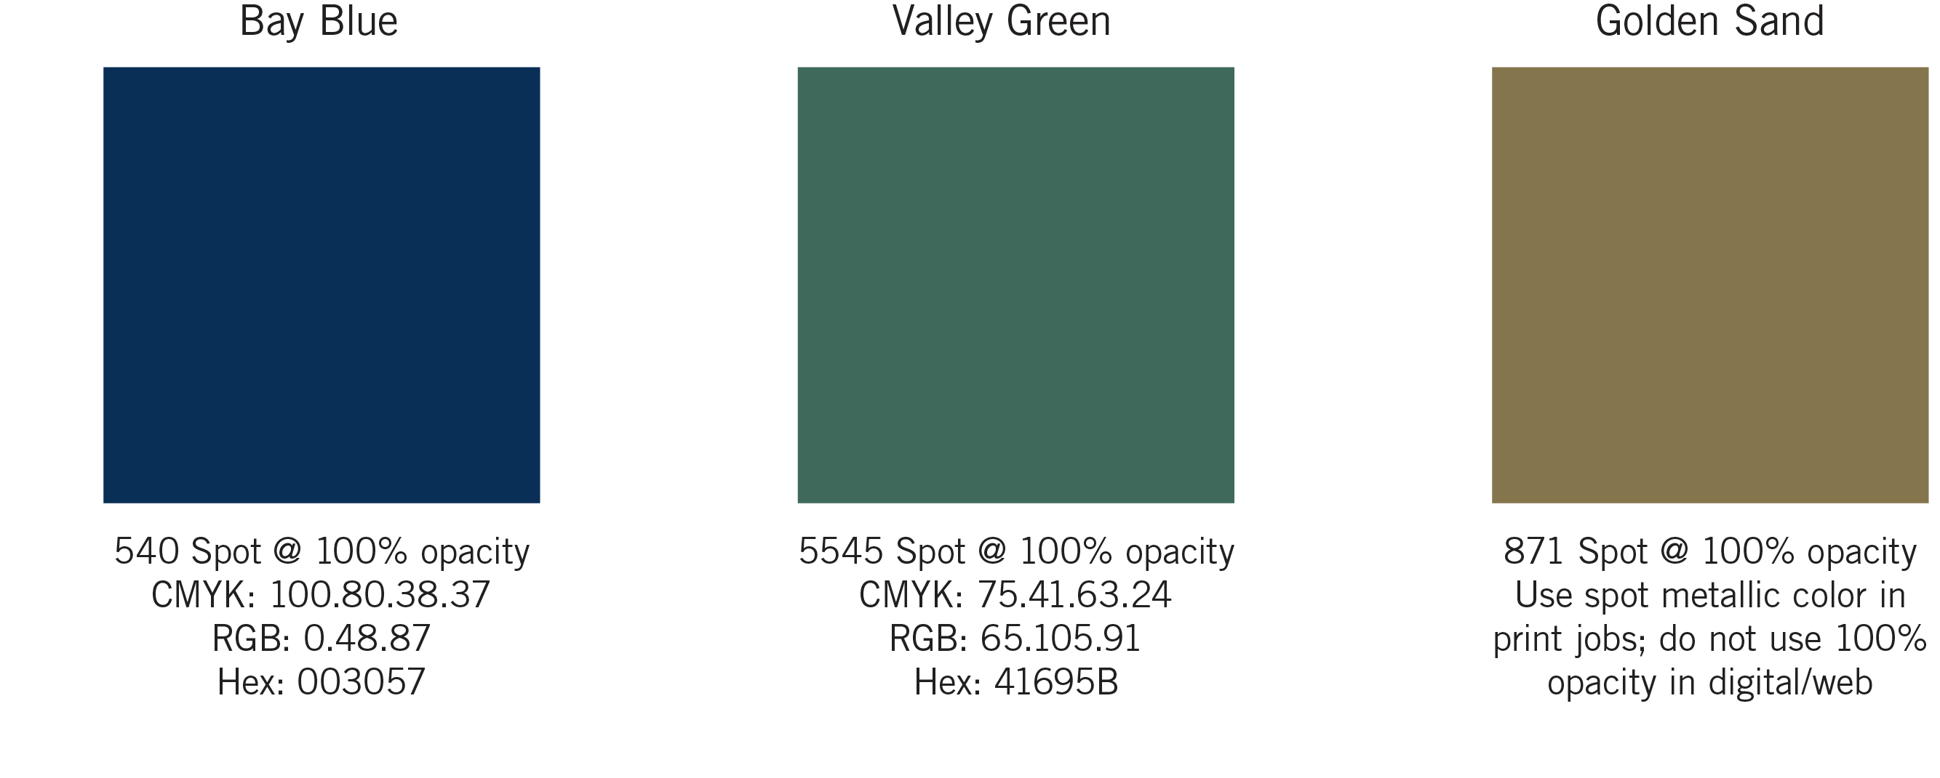
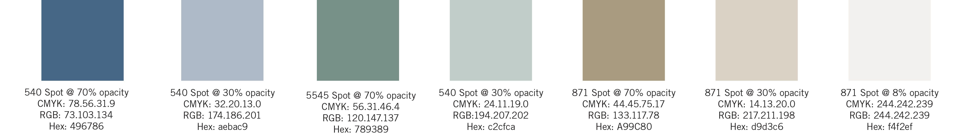
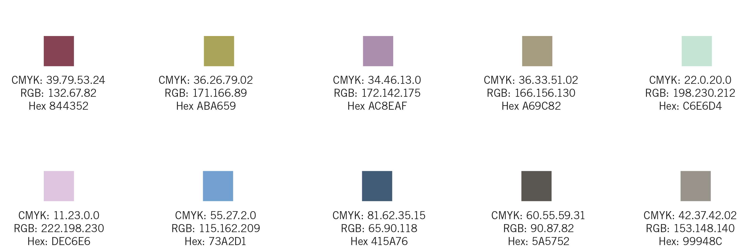
Brand colors
for variation, stick with brand colors

Slide 5
Part II: Using data and main points
avoid bullet points;
use one main point per slide instead

Slide 6
seems odd; but, trust me — I know what I’m doing here.

Slide 7
you might end up with five times as many slides as you would otherwise.

Slide 8
over 90 percent of college students agree...
...slides with less text
on them actually
say more.

Slide 9
use text color to emphasize an important point.

Slide 10
100
percentage of audience members who are engaged by PowerPoint presentations that are clear and simple

Slide 11
25
percentage of all audience members who would rather write a dissertation than watch a presentation with 5+ bullet points per slide

Slide 12
2
number of times audience members will fall asleep during a PowerPoint presentation that has 5+ bullet points per slide

Slide 13
Part III: Slides with images
for dramatic effect, use one image per slide

Slide 14

use large,
high-quality images
images that don’t become blurry, fuzzy, or pixelated
when enlarged on a PowerPoint slide.

Slide 15
to resize an image, use the resizing tool on an image’s corner (versus its side) to prevent stretching.

Slide 16
Part III: Other visual elements
charts
graphs
infographics

Slide 17
sometimes you will need to represent ideas in the form of a chart, graph or infographic.

Slide 18
for the greatest impact, use the simplest possible representation; for example...

Slide 19
Restate your main points
Colors
Data and main points
Images
Visual elements
Data
Charts
Infographics

Slide 20

conclude with a story, an image, a quote or a tie back to your introduction
for a powerful effect

